Slide 1
ERMS
DSA Project
GROUP MEMBERS
Asif Raza | Malik Muhammad Umair
Natin Masih | Muhammad Awais Altaf
Waleed Ahmed

Slide 2
AGENDA
Project Overview
Features & Roles
Data Structures Used
Code Architecture
Role-Based Dashboards
Functionality Demos
Conclusion & Q / A

Slide 3







Emergency Response & Management System

Slide 4

INTRODUCTION:
The Emergency Response Management System is a C++ program designed to handle and prioritize emergency situations such as medical, fire, crime, and natural disasters.
The Emergency Response Management System allows:
Manage and prioritize city emergencies.
Allow admin and staff to handle incidents efficiently.
Track history and staff users using classic data structures.
It operates fully in C++ using console input/output.

Slide 5
How it works?
USER LOGIN/REGISTER :
Users (Admin/Staff) log in through a simple credential system.
Admin can add new staff members with unique usernames and passwords.
Staff can log in and access tools to add and process emergency cases.
ADMIN
LOGIN
STAFF

Slide 6
How it works?
ROLE-BASED DASHBOARD ACCESS :
Once logged in, users are directed to different dashboards based on their role (Admin or Staff).
Each dashboard displays only the functions specific to the user’s role.
LOGIN
STAFF
ADMIN

Slide 7
How it works?
ADD EMERGENCY REPORTS :
Staff or Admin can add emergency details (name, type, level, location, and description).
Each report is assigned a priority score based on type and severity level.
addEmergency( )
Name
Type
Level
Location
Description

Slide 8
How it works?
Dequeue
Element with the highest priority
9
PRIORITY QUEUE MANAGEMENT :
Emergencies are stored in a priority queue (linked list), automatically sorted by calculated priority.
Highest priority emergencies are shown at the top for immediate action
Front
5
7
3
8
.
.
.
Rear
DATA
NEXT
DATA
NEXT
DATA
NULL
LINKED LIST
Enqueue
QUEUE
Head

Slide 9
How it works?
STACK
8
8
PROCESS EMERGENCIES :
Staff/Admin can remove (process) the top-priority emergency.
Processed emergencies are pushed to a stack for history tracking.
Push
Pop
1
1
4
4
2
2
6
6
LIFO (Last In First Out)

Slide 10
How it works?
VIEW, SEARCH & FILTER :
Admin can:
View entire emergency queue.
Filter by emergency type.
Search processed emergencies by keyword
(type, location, etc.).
View and manage users (add/delete staff).
ADMIN
View
Filter
Search
Add Staff
Delete Staff

Slide 11
How it works?
STACK
DATA
DATA
TRACK PROCESSED EMERGENCIES :
A history stack maintains previously processed emergencies.
Admin or staff can review resolved incidents in reverse order (LIFO)
Push
Pop
DATA
DATA
DATA
DATA
DATA
DATA
DATA
DATA
LIFO (Last In First Out)

Slide 12
How it works?
Get Current Time
1
Capture the current time to start the process.
Escalation Mechanism in Emergency Management
Automatically promote unresolved emergencies based on:
Time waited
Severity level
Ensures critical issues are not overlooked.
Loop Through Emergencies
2
Iterate through each emergency in the queue.
3
Elapsed Time Check
Determine if the elapsed time exceeds the threshold.
4
Increase Priority
Elevate the priority of emergencies that meet the threshold.
5
Reset Timer
Reset the timer for the next emergency evaluation.
6
Next Emergency
Move to the next emergency in the queue.
7
Sort Queue
Organize the queue based on priority.

Slide 13

User Roles

Slide 14
User Roles:
Admin | addStaff(), deleteStaff(), Users.displayUsers(), searchEmergency(), filterByType(), addEmergency(), displayEmergencies(), viewHistory()
Staff | addEmergency(), displayEmergencies(), deleteEmergency(), viewHistory()
Public | addEmergency() (accessed through case 2 in main() without login)

Slide 15

Admin Role:
Add Emergency
View Emergency
Filter Emergency
Process Emergency
Add Staff
View History
Delete Staff
LOGOUT

Slide 16
Staff Role:
Add Emergency
View Emergency
View Processed Emergency
Process Emergency
LOGOUT

Slide 17
User Role:
Add Emergency
EXIT

Slide 18

DATA STRUCTURES USED

Slide 19
DATA STRUCTURES:
LINKED LIST :
Used in -
UserList - For User management
HistoryStack - To store processed emergencies
PendingEmergencies - As a Priority Queue Implementation
.
.
.
DATA
NULL
DATA
NEXT
DATA
NEXT
DATA
NEXT
LINKED LIST
Head

Slide 20
DATA STRUCTURES:
LINKED LIST :
How –
Dynamically creates and links nodes containing user or emergency data.
Enables flexible node addition/removal at any position.
Why –
Dynamic memory allocation avoids wasted space.
Efficient for adding/removing users and emergency records without shifting data.

Slide 21
DATA STRUCTURES:
PRIORITY QUEUE :
Used in –
Managing and sorting pending emergencies.
Why –
Ensures the most urgent emergencies are handled first.
Supports real-world triaging logic for response systems.
Element with the highest priority
Front
Rear
2
7
5
3
1
Dequeue
Enqueue
PRIORITY QUEUE

Slide 22
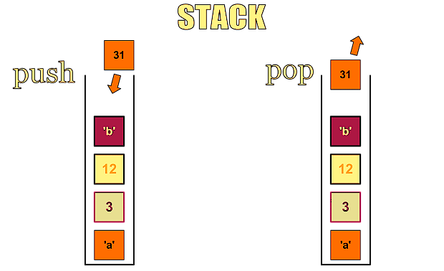
DATA STRUCTURES:
Stack (LIFO) :
Used in –
Storing processed emergencies for history tracking
Why –
Follows LIFO order – Last emergency resolved is view first.
Ideal for reviewing recent activities or undo logic.
LIFO (Last In First Out)

Slide 23
DATA STRUCTURES:
Linked List Traversal :
Used in –
filterByType() - filter active emergencies by type.
searchEmergency() – search history by type, location, or description.
Why –
Straightforward and effective for datasets of moderate size.
No additional space or indexing required.
.
.
DATA
NULL
DATA
NEXT
DATA
NEXT
LINKED LIST
Head

Slide 24
Demo

Slide 25
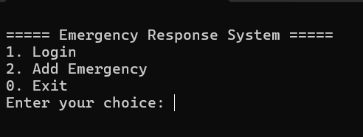
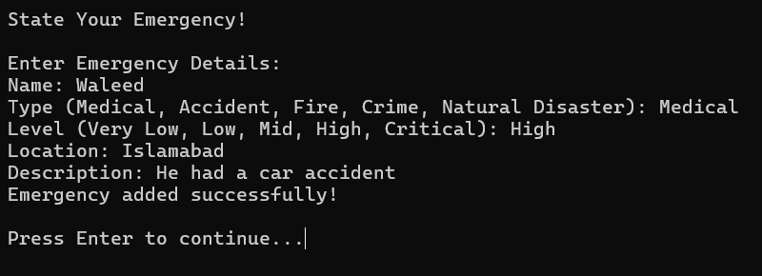
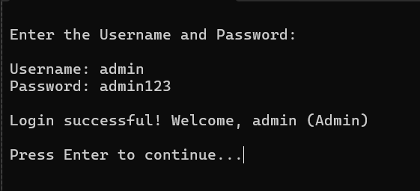
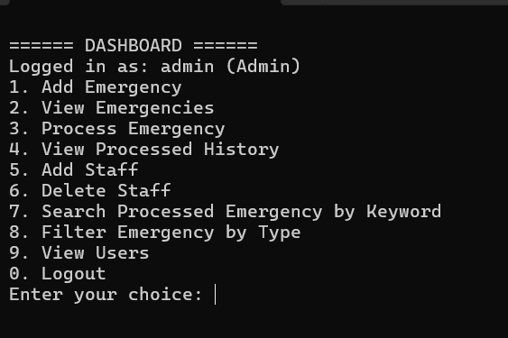
Demo :

Slide 26
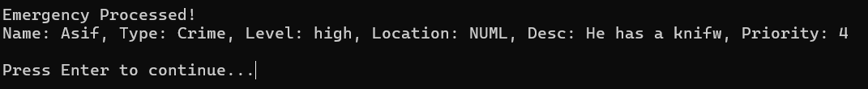
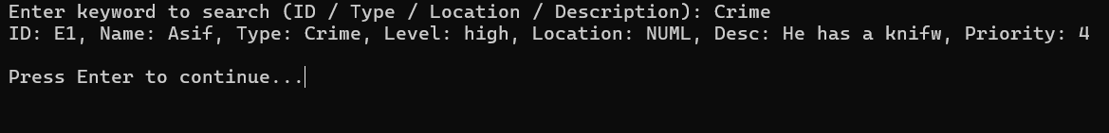
Demo :

Slide 27
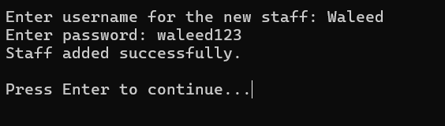
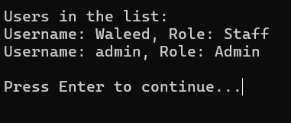
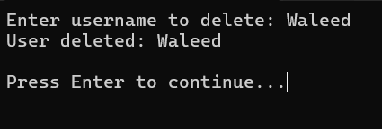
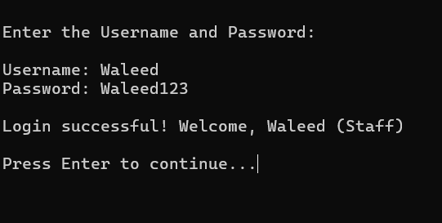
Demo :

Slide 28
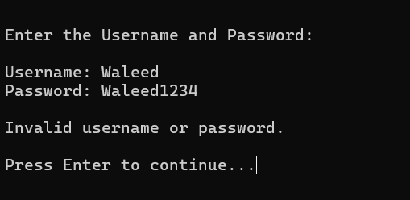
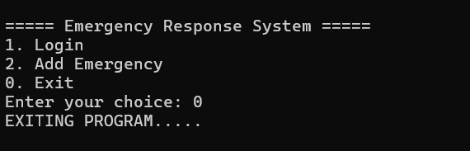
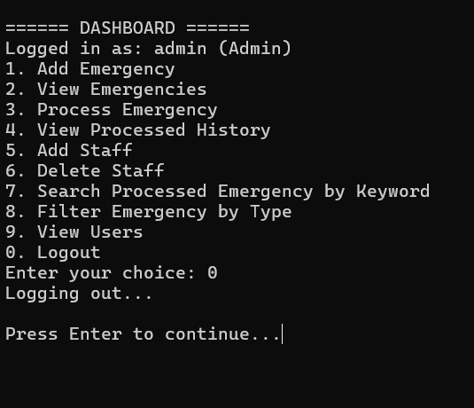
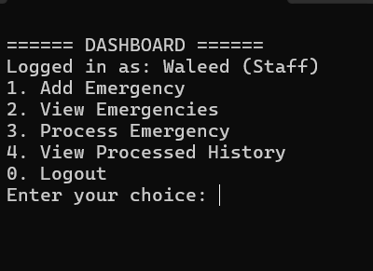
Demo :

Slide 29

Conclusion

Slide 30
Conclusion:
The Emergency Response System successfully demonstrates how classic data structures like linked lists, priority queues, and stacks can be applied in real-world problem solving. By integrating role-based access, priority-based emergency handling, and historical tracking, the system ensures both efficiency and clarity in crisis management workflows. The modular design allows future scalability, making it a strong base for more advanced emergency handling solutions.

Slide 31
Any Questions?

Slide 32
Thank You

